Slide 1
Corporate Community Engagement
MetroGAVS meeting 02 November 2023
Next phase of community engagement

Slide 2

Our Communities
Vision for 2030
In 2030 residents will have a different relationship with the Council.
The Council is focused on building services that build resilience and independence.
When an interaction is needed with the Council people are able to get the right information or service in the most efficient and accessible way possible.
Our communities have a stronger voice and feel heard.
This has been achieved through a change in the way that community engagement is carried out, with a focus on going to communities and really listening.
This regular engagement gives us a constant understanding of the challenges, hopes and fears of our communities to make sure we’re addressing the right things.
Our shared understanding of our challenges, missions and growth of community networks has led to greater levels of partnership to address challenges.

Slide 3
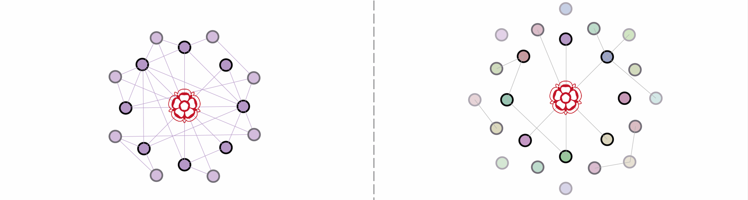
Engagement approach for public and community consultation activity
Within communities
Between communities
Involves going to where people already come together, engaging with them on their turf.
They’ll be comfortable in their own space and will help access other groups that often don’t engage with the Council.
Involves gathering people together who might not normally be in the same room.
This allows people to hear others experiences of living in the borough and identifies common ground between resident with different life experiences.
Good engagement in this context mean engaging across this inverted triangle

Slide 4
Engagement approach for public and community consultation activity
 | Engagement type | Who | Where
1 | Open access survey (Broad, Shallow, Across Communities) | Council-led | Online with face-to-face completion options
2 | Roadshows and pop-up stands at others’ events (Broad, Moderately Shallow, Across Communities) | Council-delivered at existing events, settings and community sessions | Example site: Woolwich Front Room / General Gordon Square / Other sites (static) Welcome Spaces / Advice Hubs
3 | 1-to-1 in-depth conversations (Moderately Broad, Moderately Deep, Within Communities) | Council-led with community and other Champions | Anywhere – but could target places where seldom-heard voices more likely
4 | Workshops with specific interest groups (Narrow, Moderately Deep, Within Communities) | Council-hosted, partnering with organisations. | (Potential partner orgs and their venues)
5 | Community group workshops (Narrow, Moderately Deep, Within Communities) | Partner-hosted with training, materials and thank you payment provided by Council | E.g. resident associations, sports groups etc, community specific groups

Slide 5
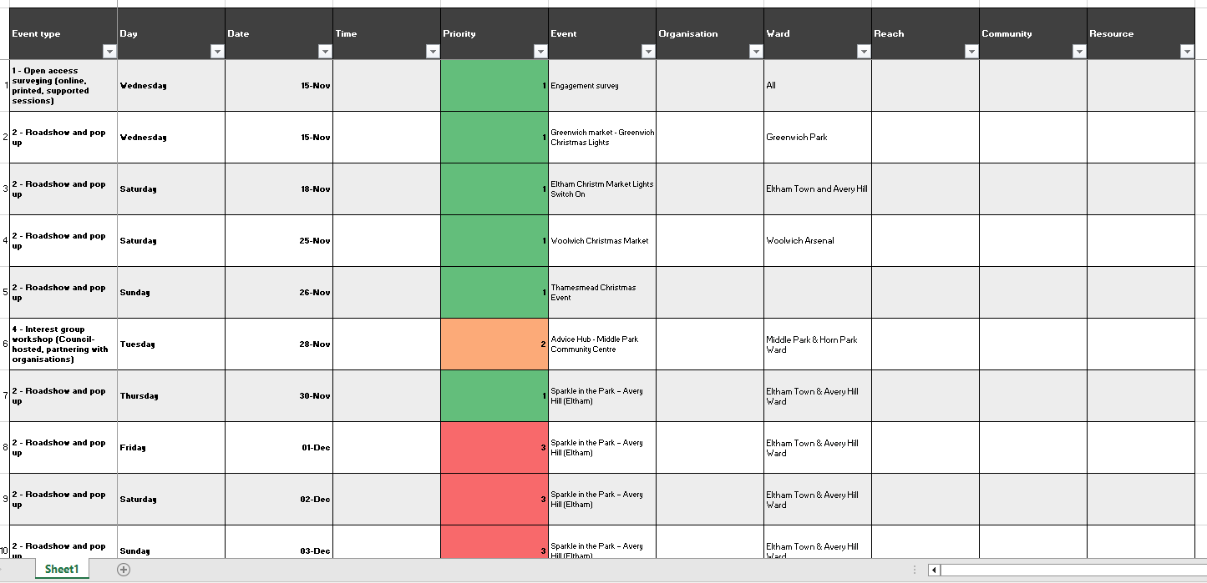
Engagement approach for public and community consultation activity

Slide 6
Progress update and draft timeline (2023/24)
  Q1 – 2023
  May
  Interim Engagement and Participation Manager Start in post
  Introduction to directors – initial request to join DMTs
  June
  Community engagement research of other local authorities
  Start of drafting Corporate Engagement Framework (outline, principles, strategy and OG alignment)
    Stakeholder mapping
  Internal teams and colleagues
  Research pieces
  Repository for consultations
  Possible training, accreditations and memberships
    Together 23 Meeting community organisations
    Colleague and teams introductions / mapping ongoing
    Engagement team research Roles and evaluations completed
  Q2 – 2023
  July
  Future of participation conference Mayor of London’s office
  London Community Engagement Network - Operational Group (co-ordinated by London Councils)
  IPC Introductions and initial member questions on current engagement
  GMT Introducing the engagement programme of work
  Project group meetings commence
  August
  Cabinet briefing Corporate community engagement
  Reference group meetings commence
  Labour group workshop on engagement currently and Framework
  September
  Research and discovery Internal workshops
  Q3 - 2023
  October
  Phase 1 discovery and research analysis
  Draft document creation/revision
  Mobilise workstreams
  November
  Develop phase 2 comms plan
  20 November to 21 January 2024 Phase 2: Community and Public consultation
  December
  Engagement and consultation ongoing
  Q4 – 2024
  January
  Close of engagement and consultation with communities and public
  February/March
  21 February Cabinet (tbc) Full approval of the Corporate Community Engagement framework
  TBC (April onwards)
  Frameworks community activities with partners over schools' spring break

