Slide 1
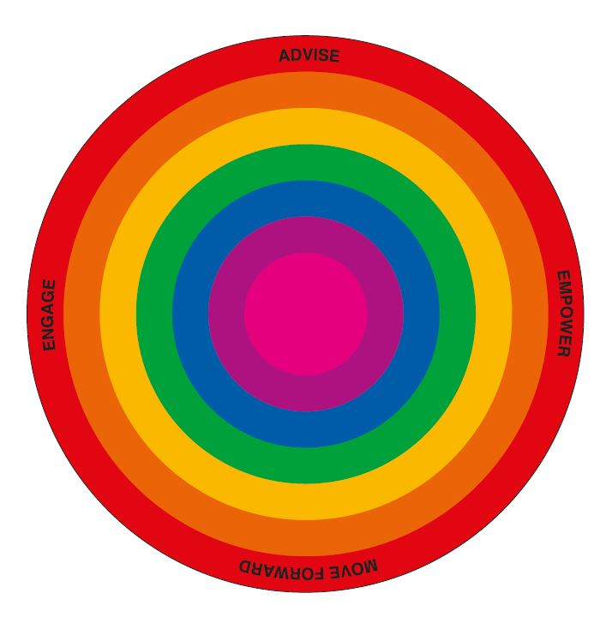
Her Centre Services and Equalities

Slide 2
Her Centre services
Her Centre empowers women to move away from abuse and forward with their lives.
Based in Greenwich, we offer:
Domestic and sexual abuse advocacy from 13 years and older and support for children
Support and social groups, counselling
Forums on women’s issues
Free women only classes

Slide 3
Her Centre
Our services are in demand: in 2022/23
Women engaged by IDSVA services | 856
Referrals (all referrals contacted at least 3 times) including self referrals | 1116
Attendees at Training and Events | 566
Took up Group or One to One Counselling | 103
Women engaged for support addressing wider VAWG | 114

Slide 4
IDSVA - What we provide
The Independent Domestic and Sexual Violence Advocacy Service (IDSVA) provides:
Risk Assessment & MARAC Representation
Practical help & information
Emotional Support and awareness raising
Advice on Family legal issues
Support at County, Magistrates & Crown Court
Assistance with Housing
Support Groups, Counselling and work placement

Slide 5
Other specialist IDSVA posts
Her Centre also provides:
A Children’s IDVA working with children – refer Nicole.Nwafor@royalgreenwich.gov.uk
A sexual violence advocate working with stalking and stranger abuse - open referrals
A young IDVA supporting 13 to 19 year old girls – open referrals
Housing IDVA service with Housing Inclusion

Slide 6
One Stop Shop and GPs
One Stop Shop
Drop-in on Fridays 10 to 12 at YMCA Woolwich and Wednesdays at St Mary CC in Eltham and Moorings in Thamesmead
Help from a family solicitor and IDSVA
Health IDSVA
Running GP training and taking GP referrals

Slide 7
How to refer
Our young IDSVA and Sexual abuse advocate take open referrals
Our One Stop Shop is the best starting point if someone wants legal advice or just has questions
For women at high risk, please do a MARAC referral to MARAC-Referrals@royalgreenwich.gov.uk

Slide 8
Outreach
Our Outreach coordinator helps women rebuilding their lives
Help to find qualifications and work placements through information days
English, IT, parenting and confidence classes
Links to women’s social groups including new communities’ groups
Contact julia@hercentre.org for more info

Slide 9
Training we offer
Our Basic English classes run for 10 weeks 3 times a year including a speaking class
We also are setting up money management
Our 4-week confidence building classes help women find their voice again
Basic IT classes help women manage finances, benefits and payments online
Parenting power course helps rebuild families

Slide 10
Groups for women
Her Centre also provides
A women’s social group to build friendships
Groups run by volunteers from new communities to engage all women
Group events and activities such as our holiday celebration and seaside trips
Open Forums open to all, on key women’s issues

Slide 11
Her Centre
For general domestic abuse questions Greenwich fund the DV helpline on 0208 317 8273
For more info on Her Centre services contact us on 0203 260 7772
Any Questions?

