Slide 1
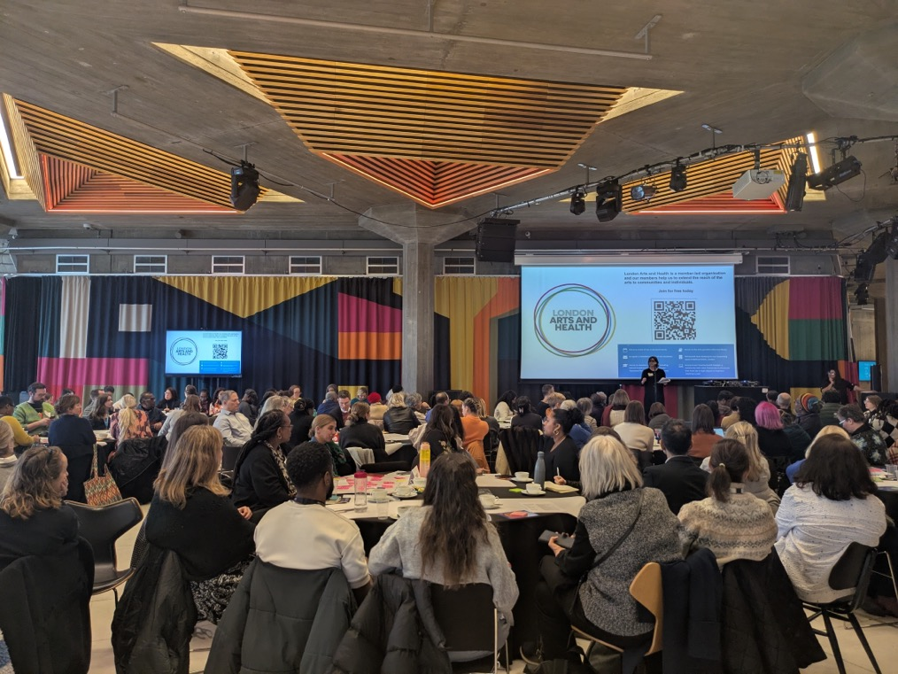
Creative Health Lead, SEL Integrated Care Board
Flora.Faith-Kelly@selondonics.nhs.uk

Slide 2
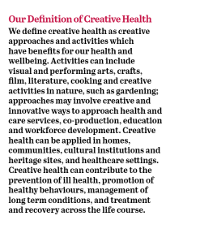
What is Creative Health
Promoting a personalised approach - creativity promotes choice & conversations – highly personalized
Creativity as preventative health tool: helps keep people well, connected, happy.
Enabling: creativity as tool for staying well through illness – Parkinson’s, Dementia, Stroke, Cancer, Mental Health
Creativity as amplifier: Uplifts and expresses lived experience – Creative expression
London wants to become a Creative Health City

Slide 3
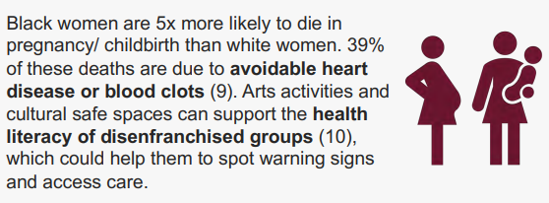
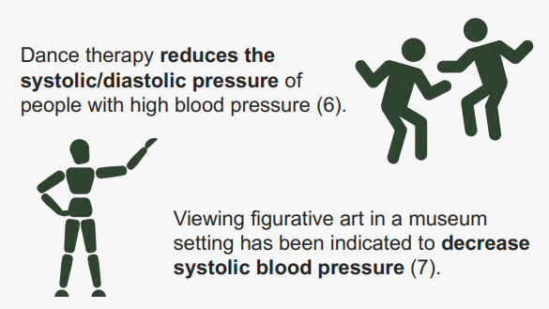
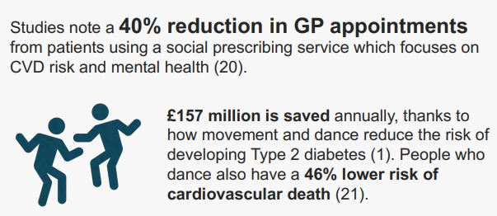
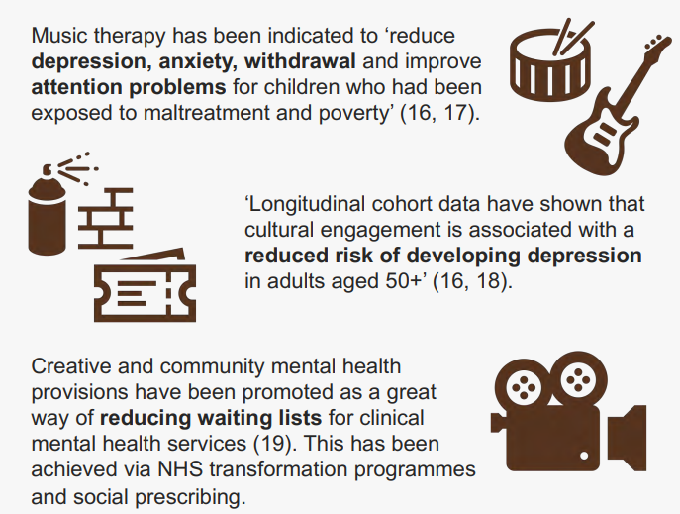
The Evidence on Creative Health

Slide 4
Creative Health Lead Priorities
Advocacy and profile raising
Advocating for creative health organisations and their contributions to be valued within the Integrated Neighbourhood Model & wider ICS working
Platforming the impact creative health is having in SEL on reducing health inequalities
Sharing the growing evidence base of creativity’s impact on health & wellbeing
Network support & information link up
ICS wide event at Southbank Centre 12th February – How Can Creativity Reduce Health Inequalities
Mapping – London Arts and Health Creative Connections Map,
Place Level working groups and network development – Marketplaces, Networks
Building a shared language across shared vision & impact
London Plus Impact Framework & Creative Health Quality Framework
Naming Creative Health in strategies – Culture, Regeneration, Public Health
Utilising opportunities for test & learn with creative health

Slide 5
Borough Level Creative Health Next Steps
Borough | Focus Area
Lewisham | Creative Health as part of Integrated Neighbourhood Model – Developing a model for embedding creative health interventions
Greenwich | Creative Health knowledge exchange & peer support – network support for those delivering creative health, utilising Specialist Topic Community Champions to support uptake.
Lambeth | Showcasing Creative Health – Providing marketplace opportunities to showcase available creative activities to community & health sector – aiming for September 2025 Southbank x ICB Partnership on Young People’s Mental Health
Southwark | Evidencing Creative Health – Applying the Creative Health Impact Framework in Southwark – building a shared language around creative health – Becoming a Creative Health Borough – Hosting a Creative Health Roundtable
Bromley | Making Creative Health visible
Bexley | Growing a Creative Health network

Slide 6
Resources for Creative Health
Utilise Impact Framework across SEL
Creative-health-quality-framework
Building SEL presence on Creative Health Connections Map – London Creative Health City: Building it together
Creativity and Wellbeing Week
Creative-Health-at-a-Glance-_-Booklet.pdf
London’s Creative Health Sector | London City Hall

