Slide 1
Introducing

Slide 2
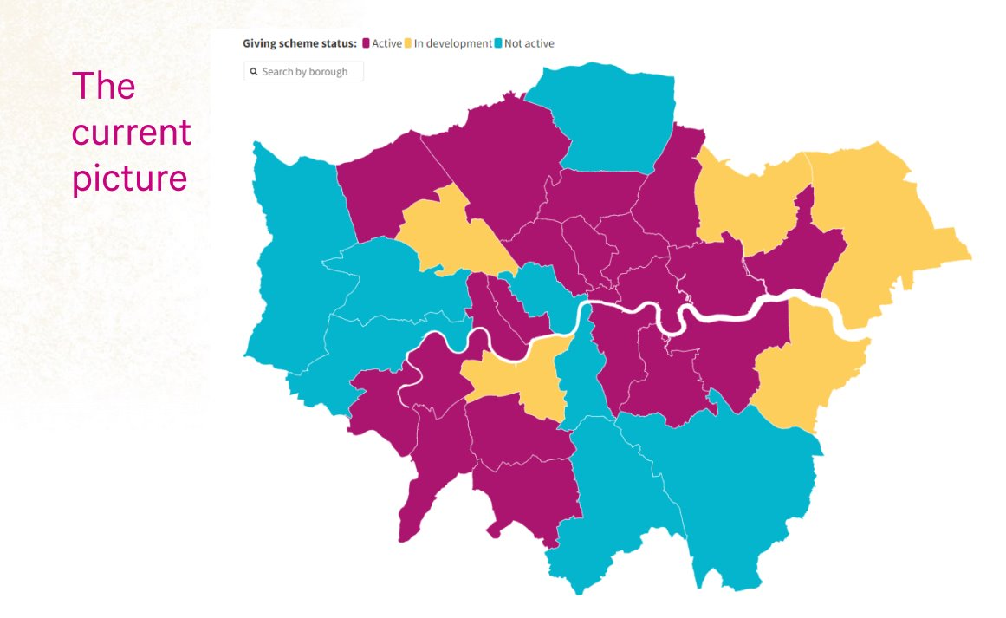
Local giving
Residents
Grassroots
Groups
Charities
Corporations
Community groups
Local businesses
Public sector

Slide 3
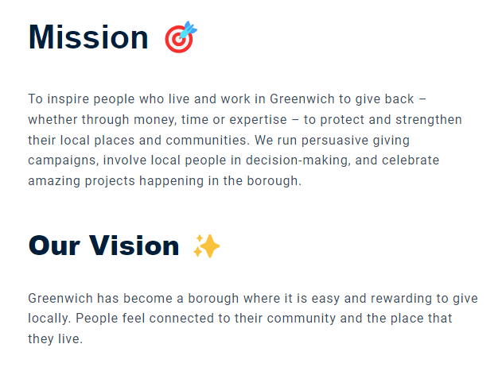
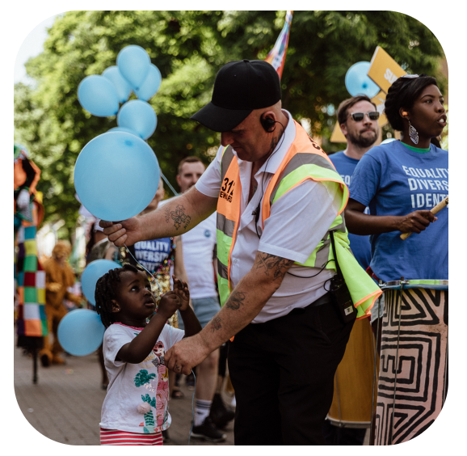
Home | Greenwich Giving

Slide 4
Values
These reflect the core beliefs which structure our work and guide our decision-making.
Expertise is diverse: We value expertise gained from lived experience, education and employment. We aspire to include different sorts of expertise in our decision-making and be guided by diverse voices.
Connections create change: We prioritise opportunities to foster positive relationships between different groups and individuals in Greenwich.
Access should be easy: We want to remove common barriers to giving and receiving support, by making our processes as simple as possible. We aim to actively engage individuals, communities and organisations who are currently not involved with services, funding opportunities, or giving.

Slide 5
“If you had to choose one theme for Greenwich Giving's first campaign…”
Notes:
Some other themes suggested:
Temporary Housing & Homelessness
The Working Poor
Climate change / energy efficiency
Environment
Support and hobby groups for people between 24 - 34 who have a disability that is not autism or adhd.
Multi Cultural events & Activities for all
I think we need to reduce the stabbings and gang related deaths in the area.
Getting closer to nature
Debt and welfare benefits support

Slide 6
People told us:
Social Connection
I think that building community and address social isolation works to address, in some way, the other categories offered
I experience and I've seen huge demand on services in Greenwich and isolation and loneliness has been a very common theme.
There are far too many people who feel isolated whether because of age, health issues or money issues.
so many of the 'groups' that used to exist – tenants, craft, mother & toddler, adult education, sport. lunch clubs, pop-in 'cafes' - have been lost, there are not the places/events that encourage social interaction.

Slide 7
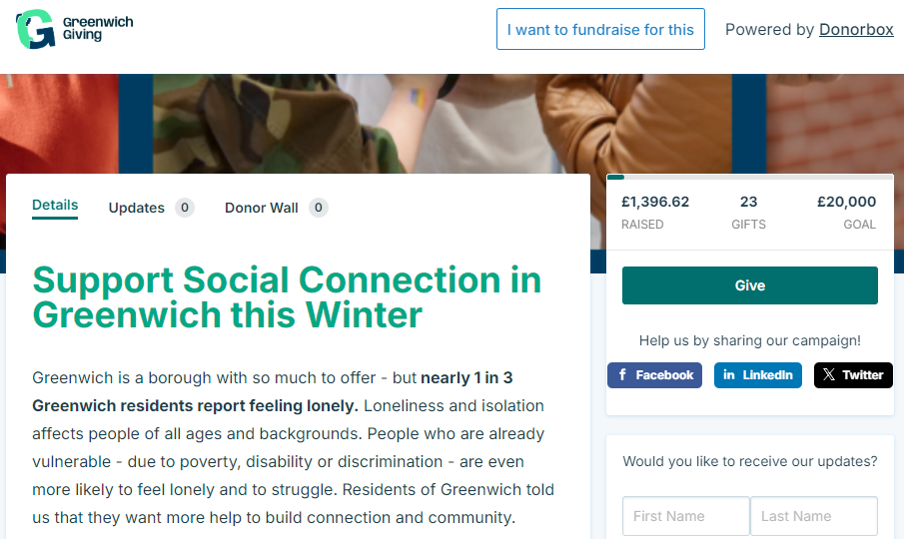
Our First Giving Campaign
Support Social Connection in Greenwich this Winter | THE METRO CENTRE LTD (Powered by Donorbox)
Notes:
Some other themes suggested:
Temporary Housing & Homelessness
The Working Poor
Climate change / energy efficiency
Environment
Support and hobby groups for people between 24 - 34 who have a disability that is not autism or adhd.
Multi Cultural events & Activities for all
I think we need to reduce the stabbings and gang related deaths in the area.
Getting closer to nature
Debt and welfare benefits support

