Slide 1
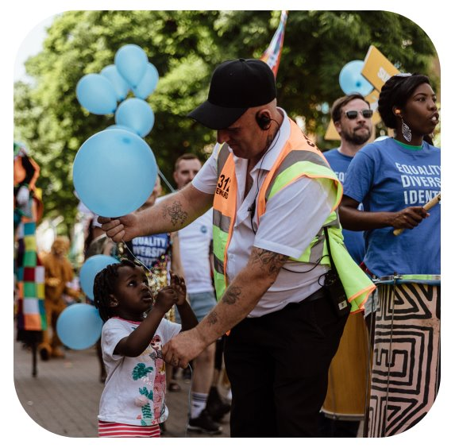
Who We Are
Our Mission 🎯
To inspire people who live and work in Greenwich to give back – whether through money, time, or expertise – to protect and strengthen their local places and communities.
How we do it 📈
We run persuasive giving campaigns, involve local people in decision-making, and celebrate amazing social impact happening in the borough.

Slide 2
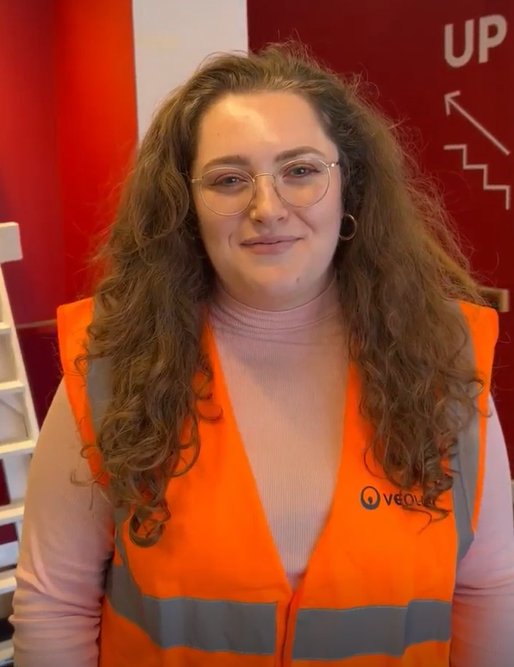
Greenwich Giving campaign for grassroots
Greenwich Peninsula Social Clubs Fund
Facilitating Pro-Bono Support for the VCS

Slide 3
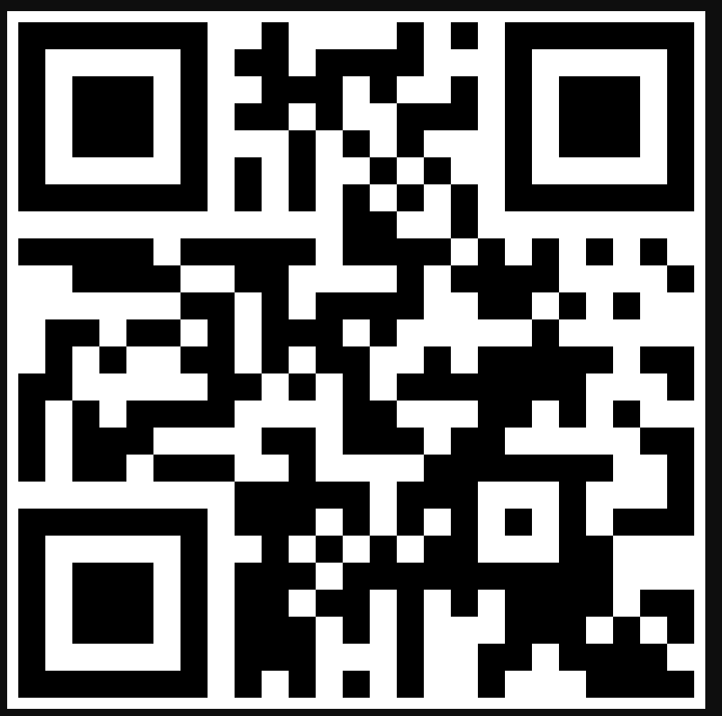
How to get involved
Follow us on social media:
Our handle is @GreenwichGiving on all platforms.
Instagram, Facebook, Twitter, BlueSky, LinkedIn
Chat to me about becoming (or recommending) a steering group member:
We would love more representation from Greenwich residents interested in disrupting the usual routes for philanthropy in the borough.
Sign up to the mailing list

