Slide 1

Walking and Cycling Grants London (WCGL)
Notes:
Welcome and thank you for joining us!

Slide 2
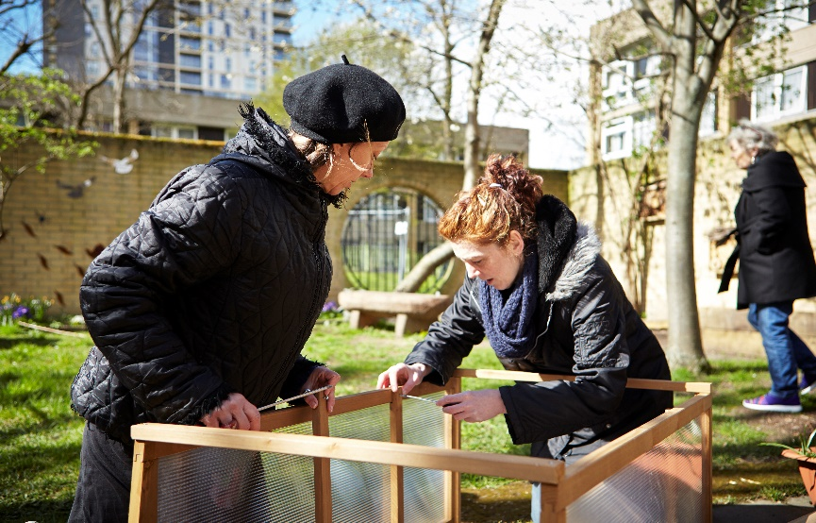
Groundwork London
Social and Environmental regeneration charity, working throughout Greater London to:
Create Better Places;
Promote Greener Living and Working; and
Improve people’s prospects.
Part of a Federation of Trusts across the UK, working towards the same aims.
Notes:
So Groundwork is a federation of charities we are an environmental and social regeneration charity, working closely with communities throughout Greater London.
We want to:
Create better spaces by planting more trees, improving green spaces to better serve communities, funding green community projects etc.
Promote Greener ways of Living and Working we have a great team of Green Doctors to create new spaces, and upcycling old household white good, the Good Store
Improving People's Prospects through coaching and training to help unemployed and economically inactive people find employment.

Slide 3
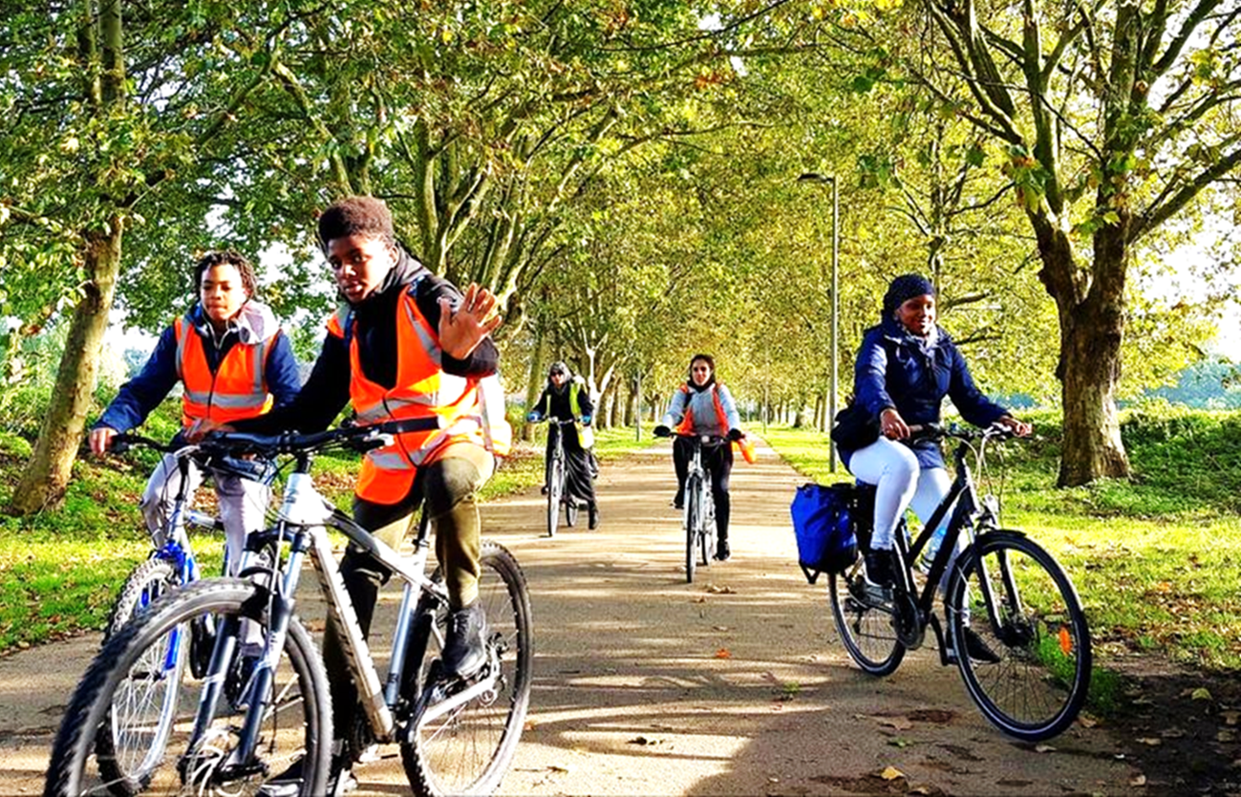
Walking and Cycling Grants London
  Aims of WCGL are to:
  Promote and encourage more regular and safe walking and cycling, by:
    targeting London’s diverse groups and communities, especially those which traditionally are under-represented in walking and cycling, and
    remove the barriers for those groups and communities to walking and cycling.
Notes:
London is fast becoming an active travel city, especially as we adjust to life coming out of the pandemic.
We want to promote and encourage regular and safe activities around walking and cycling.
We particularly want to see applications that target London’s diverse communities and groups, especially those that are traditionally under represented in these activities
And we want to remove the barriers for those groups to get involved with walking and cycling

Slide 4
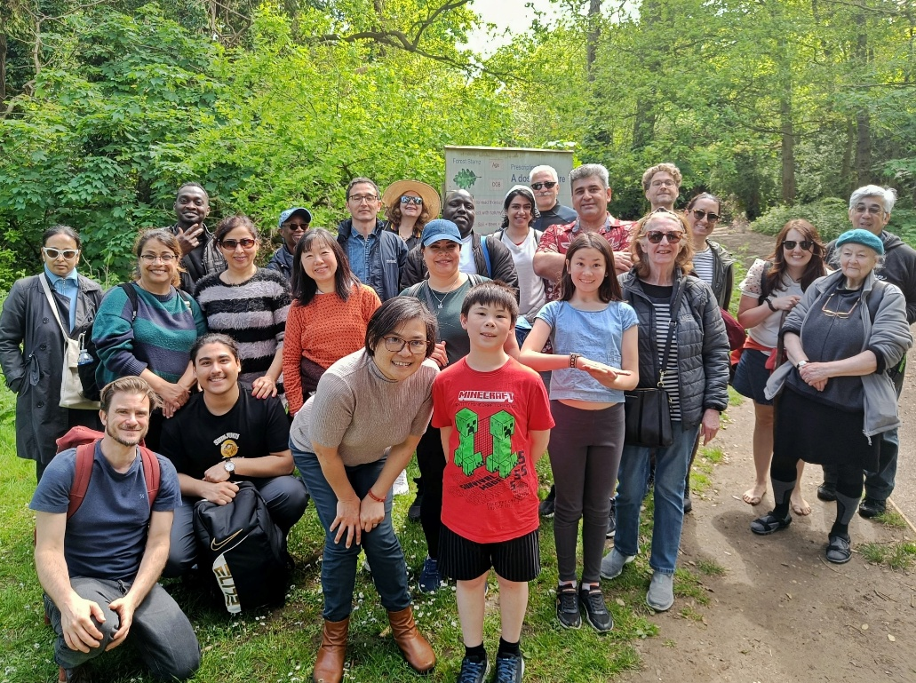
Walking and Cycling Grants London
  Funded by Transport for London in partnership with the London Marathon Foundation.
  Groundwork London has been administering the grant programme since 2015.
  In 2024, we received over 139 applications.
  In this time we have awarded c.£4.7m in grants and supported 474 projects across all 33 London boroughs, with over 90,000 participants benefitting.
Notes:
WCGL is funded by Transport for London in partnership with the London Marathon Charitable Trust and administered by ourselves, Groundwork London. We have been administering the grant programme since 2015.
For this year we are likely to be supporting around 50 projects.
Almost 8,000 walks/rides delivered each year.
Over 10,000 participants each year

Slide 5
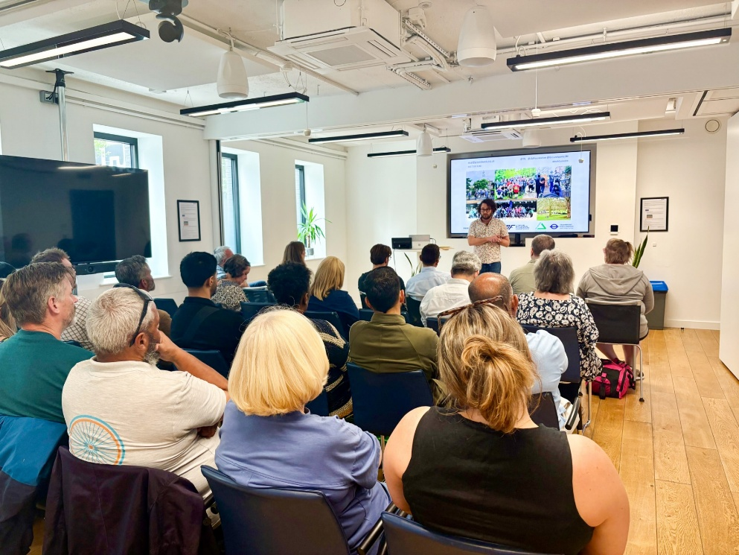
Walking and Cycling Grants London
  WCGL supports successful organisations with a range of training and networking opportunities.
  First Aid (Level 3, valid for 3 years)
  Ride and Walk Leader
  Bike Maintenance
  Project Management
  Branding and Marketing
  Monitoring and Evaluating
Notes:
WCGL also supports a good range of training opportunities for staff and volunteers to build skills within organisations. Some of the most popular ones are Frist Aid training (Level 3, which is valid for 3 years), Ride and walk leader course, Bike maintenance, project management, branding and marketing, monitoring and evaluation.
In this year, so far, we delivered
6 day long First Aid training sessions, where 62 grantees received Level-3 certificates.

Slide 6
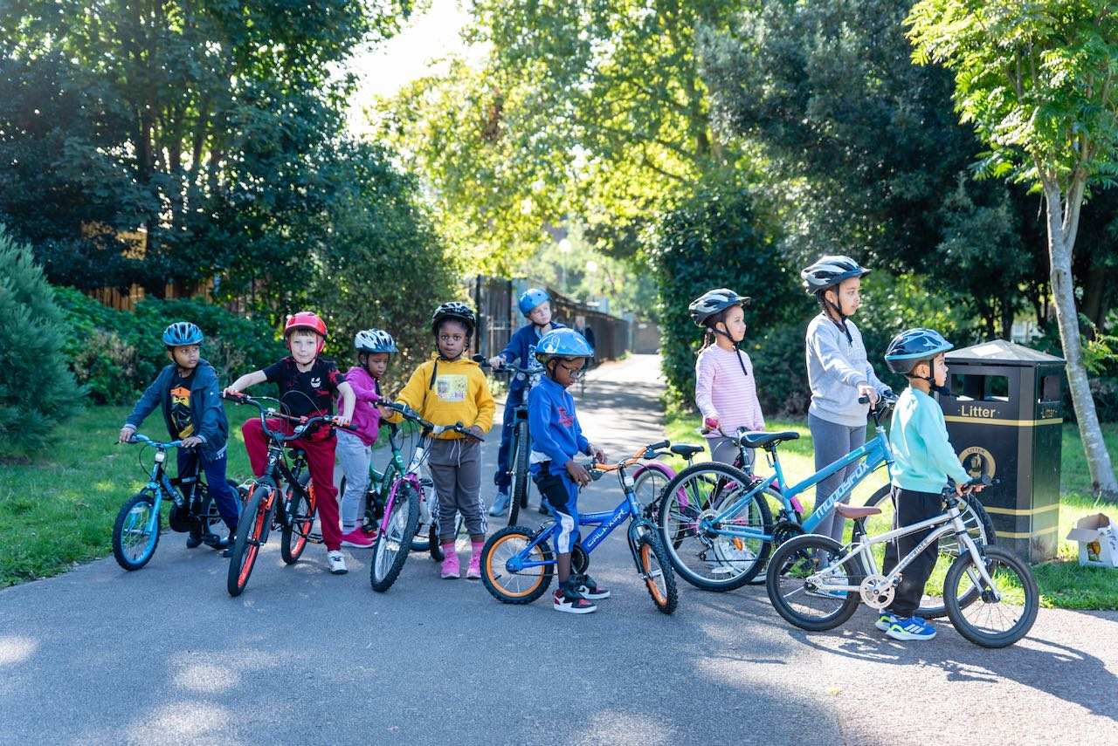
Walking and Cycling Grants London
  For new projects in 2025 Walking and Cycling Grants London (WCGL) will fund grants of up to £5,000. Minimum of 30 participants for this level of funding.
  Grants support activity between January and September 2026.
Notes:
Organisations that have not previously received Walking and Cycling Grants London (WCGL), Cycling Grants London (CGL) or Community Cycling for London (CCFL) funding, or those that have received previous WCGL funding but are developing a new project, can apply for a total of up to £5,000 over one year.
A project is considered new if it meets at least one of the following criteria:
• The project has a new deliverable, or objective
• It is targeted to a distinct new audience
• It is delivered from a new branch of an existing organisation
• It is delivered in a new geographic location
• It is a completely different project/idea from the one that was funded by WCGL, CGL or CCFL

Slide 7
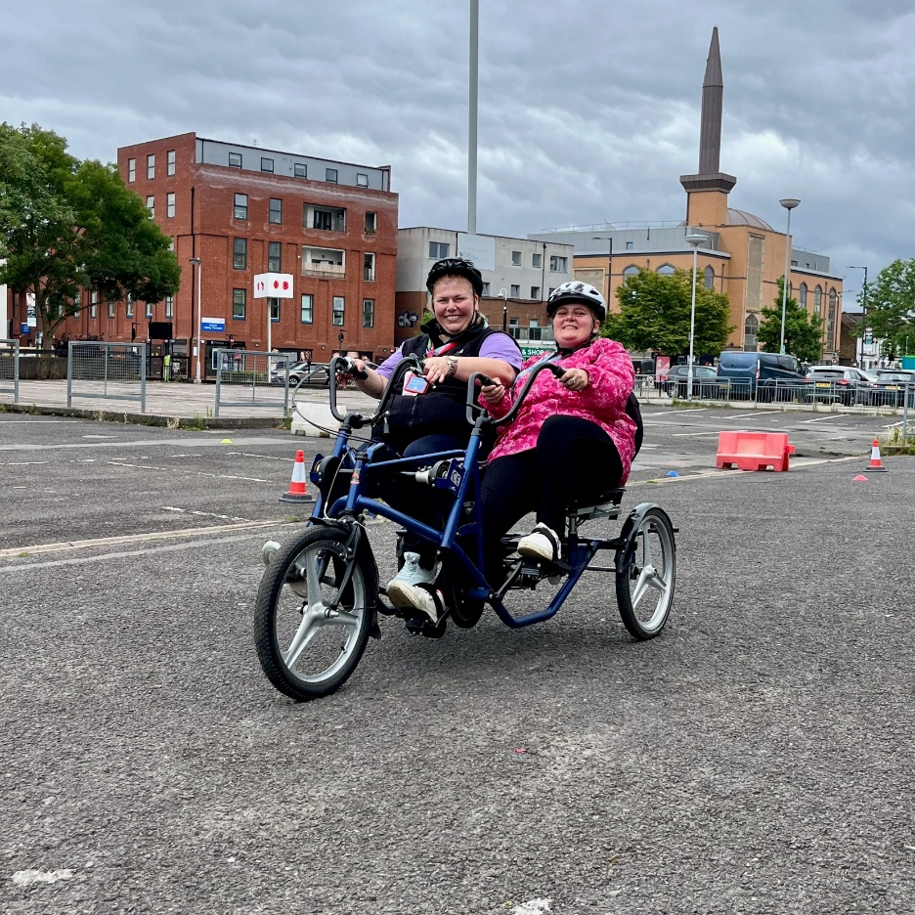
Walking and Cycling Grants London
  Eligible organisations operate within Greater London and are:
  Constituted Community groups;
  Charities or third sector organisations; or
  Not for profit organisations, community interest companies (CIC) or a social enterprise.
Notes:
To apply for a WCGL grant, your organisation must operate within Greater London and be either:
• A constituted community group (an organisation or association of persons with the primary aim of working to provide services and benefits to the community)
• A not for profit organisation, community interest company (CIC) or social enterprise
• A charity or third sector organisation
Unconstituted groups cannot apply. If you are an unconstituted group you may be eligible for the Community Training Grant, please take a look at our website or get in contact for more information on that grant.
Please note that we will ask you to provide evidence of the legal status of your organisation.
Schools and ‘for profit’ businesses are not eligible to apply for WCGL funding. In order for a school to benefit, the application needs to be submitted and project administered by an eligible organisation, and the project must engage with children and the community beyond the enrolled school pupils.

Slide 8
WHAT ARE FUNDERS LOOKING FOR?
Funding criteria: Does the project meet the funder’s criteria?
Identified need: Will the project meet an identified need? Does this project address a gap in service provision?
Track record: Can the organisation deliver the outcomes / does it have qualified / experienced staff?
Network: Does the organisation have a presence within the community / borough and established network?
Budget: Is the budget realistic, cost effective and good value for money?
Sustainability: How will the project benefits be sustained / Who will maintain the project? Volunteers for example.
Notes:
What are funder looking for?
Funding criteria: Make sure your project clearly meets our criteria and the aims we have laid out. Make sure you thoroughly read all of the guidance materials available on our website prior to beginning the planning process. You can find all the resources on the WCGL website, in the Community Ideas Hub tab at the top. There are also some helpful case studies there to give an idea of what has previously been supported.
Identified need: It is important that you have researched the area you are looking to deliver, in order to establish what the need is and whether the project is delivering something different, or additional to what is already on offer. It also gives you an idea of what the demand for the project will be, to understand how many participants you may engage.
Track record: We would like to understand how experienced you are at delivering projects. There is a specific question in the application form that addresses this but keep in mind that you don’t have to have experience in delivering the specific training you have planned for this project. We would be interested to see if you are planning on partnering with any organisations or service providers to fill a gap in your skills (e.g. cycle training, bike maintenance) and experience with working with your target participants
Management: Although we do offer support to successful grantees to help implement financial and project management systems in line with the requirements of this programme. It is important that you demonstrate what experience your organisation has in managing projects, as the assessment panel will look for you to demonstrate that you have the capacity to deliver the project. It also gives us confidence when you have presented a really clear project plan of how you will deliver, key milestones etc as John has covered.
Network: Why are you best placed to deliver this project, is it due to your connections with potential participants, your reputation for high quality work?
Budget: We want accurate and realistic budget. We want to see good value for money, think about how many participants you are reaching, how intensive your project is. Please make sure you read the terms and conditions to ensure you are requesting eligible funds. These can be found on the WCGL website with the resources in the Community Ideas Hub tab at the top.
Sustainability: This is included as one of our application questions – its really important that you consider what the next steps are for your project, and how you can work to ensure that you are sustainable beyond the grant funding. Think about what legacy the project leaves and if purchasing capital items (such as bikes) how will they be used/maintained repaired in future. You may want to think about training volunteers or staff members.

Slide 9
Timeline
Application deadline – 10am, Monday 8 September
Outcomes – End of November
Delivery – January – September 2026
Visit - https://wcgl.london/
Phone: 020 7239 1286

Slide 10

Greenwich Healthier Communities Fund
Opens: Monday 15 September
Aims
Prevent: Preventing health and wellbeing inequality in Greenwich
Respond: Responding to current key health and wellbeing issues in Greenwich and reducing inequality in health and wellbeing outcomes
https://www.groundwork.org.uk/london/greenwich-healthier-communities-fund-grants/
Enabling Strand | Micro Grants | Delivery Strand
 |  | Small | Medium | Large
Amount available | £500 to £5,000 | £500 to £5,000 | £5,001 to £20,000 | £20,001 to £50,000 | £50,001 to £200,000
Suggested grant timescale | Up to 6 months | Up to 6 months | Up to 12 months | Up to 18 months | Up to 24 months

